Slide 1
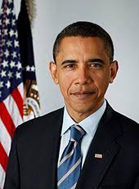
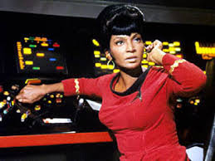
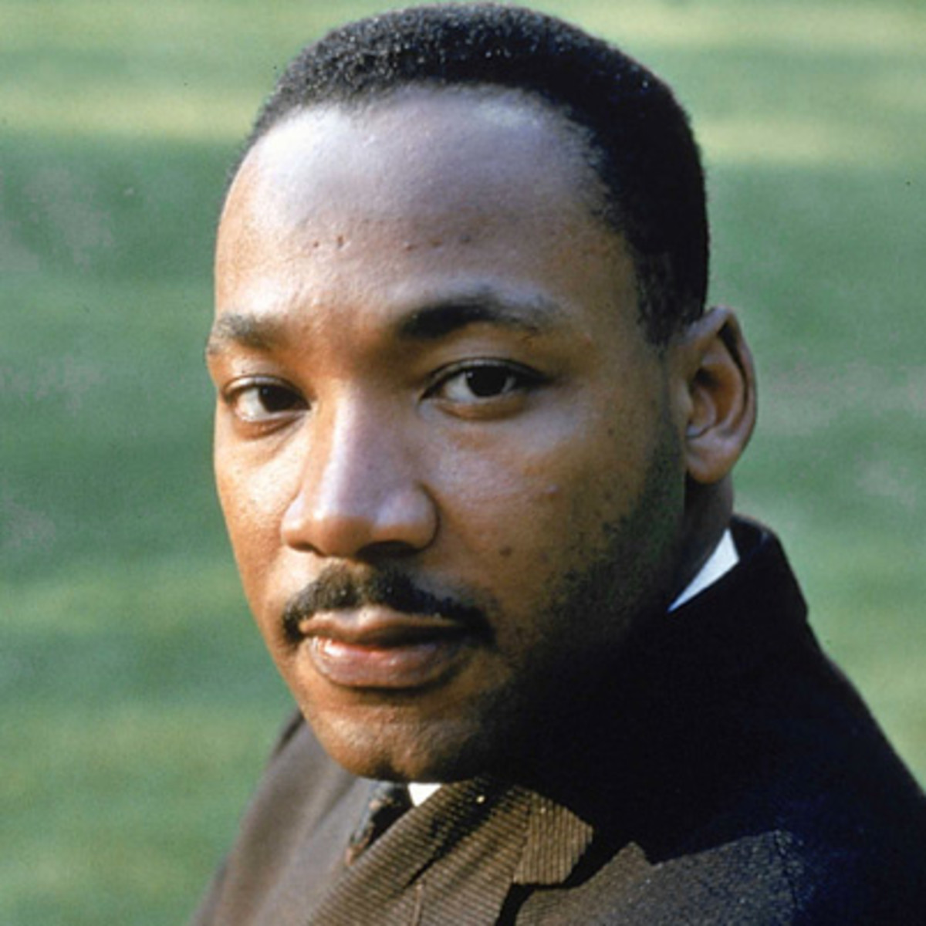
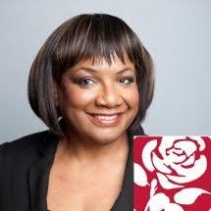
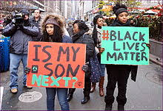
Black History
Month
TOTW

Slide 3
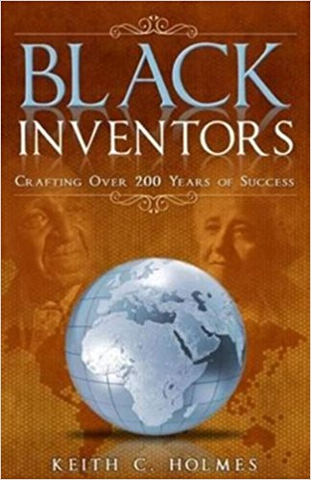
Black History
Month 2024
Why do we need a Black History month?
Name as many white inventors you can think of.
Name as many black inventors you can think of.
https://www.youtube.com/watch?v=TNfH41-LI4w
How many of the notable black figures from history have you heard of from this boy’s speech?
Why is this? Would all of this history be enough to cover in one month?

Slide 4
Up until Nichols’ character appeared on popular American series Star Trek in 1966, every black female on TV had been portrayed as a maid or a menial worker.
Now imagine seeing Lieutenant Uhura for the first time – a successful translator and communications officer who specialises in linguistics, cryptography, and philology. IN SPACE!
One of the First black female fictional characters demonstrated positively on TV
Lieutenant Nyota Uhura
Originally played by
Nichelle Nichols in the
Star Trek series.

Slide 5
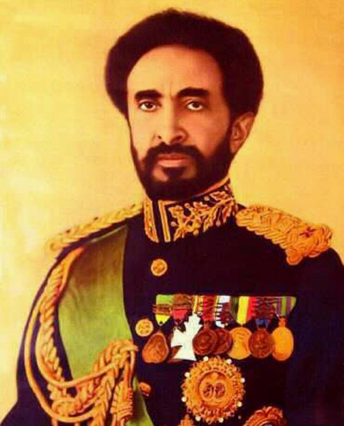
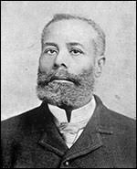
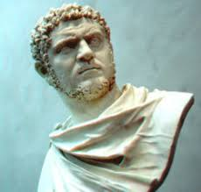
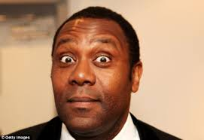
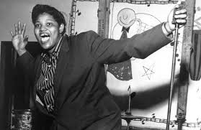
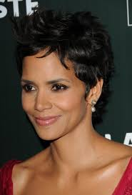
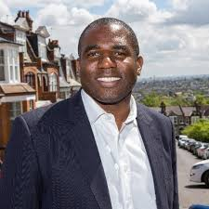
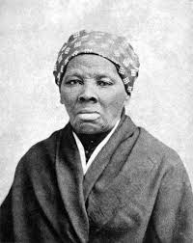
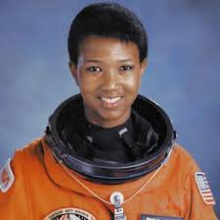
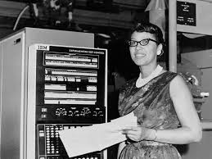
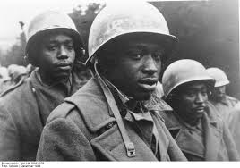
Who and what will you discover?

Slide 6
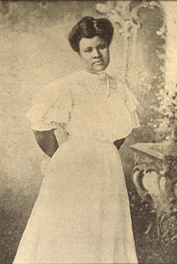
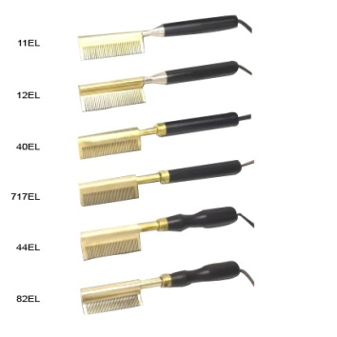
The best way to learn
Is to educate yourself
Research Black inventors, educators, religious leaders, anyone who has made a positive impact on the world.
BEFORE
AFTER

Slide 7
Oct 2024

