Slide 1
Our Ethos - 3 R’s
Respect Relationships Responsibility

Slide 2
We only have 3 school rules

Slide 3
Be Respectful
Be Respectful to all members of our community, our resources and environment

Slide 4
Be Responsible
Be Responsible for your words and actions. Always act in a safe manner

Slide 5
Build Positive Relationships
Build positive Relationships with all members of the community and show a ‘Mind to be Kind’

Slide 6
Know the 3 Rules
Live the 3 Rules
Build Positive Relationships
Be Respectful
Be Responsible

Slide 7
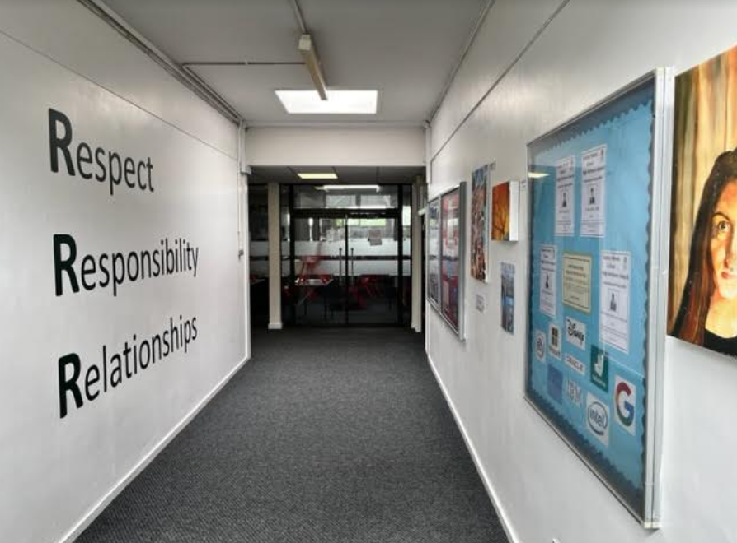

Slide 8
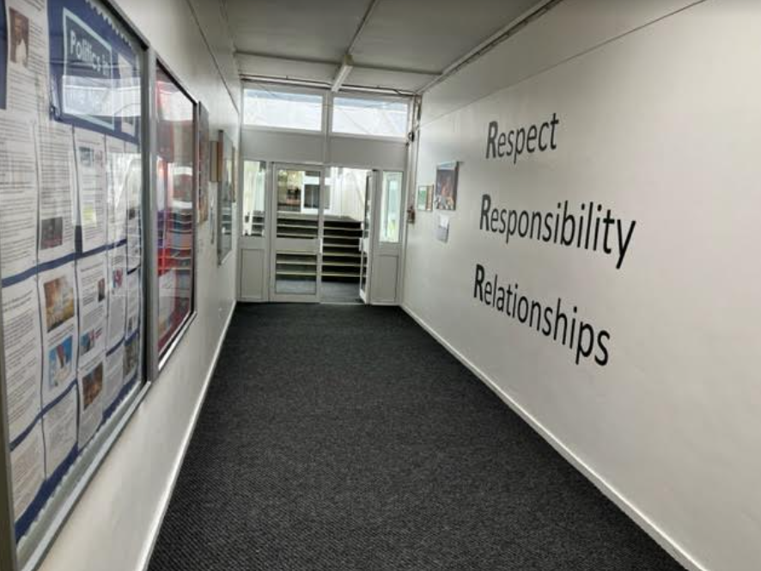

Slide 9
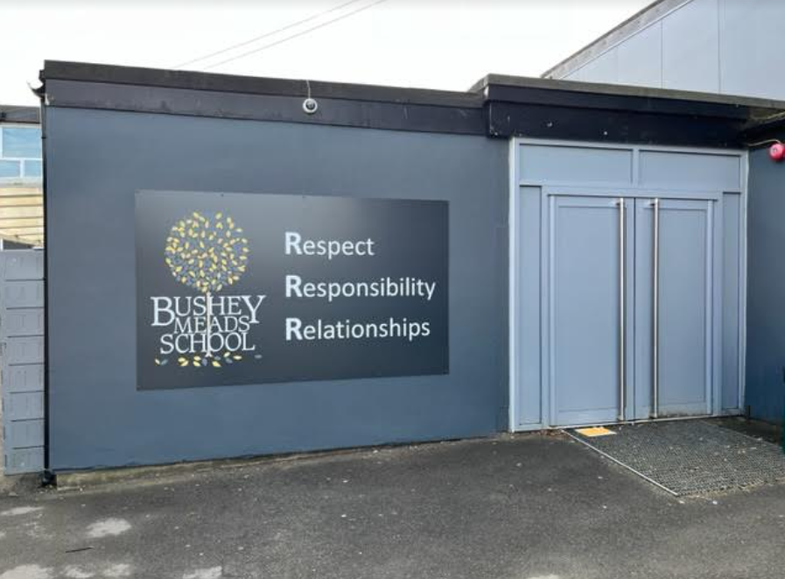

Slide 10
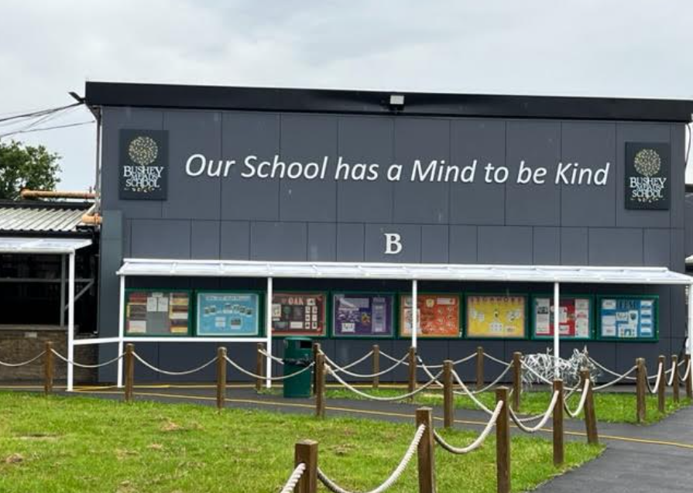

Slide 11
